Slide 1


PHP Data Objects
Dr. Jenila Livingston L.M.
SCOPE

Slide 2
PHP Data Objects (PDO)
PDO is an interface for accessing PHP databases without tying the code to a particular database.
Instead of calling mysql , mysqli , and pg functions directly, developers may use the PDO interface to streamline application porting to other databases.
Dr. L.M. Jenila Livingston, VIT Chennai

Slide 3
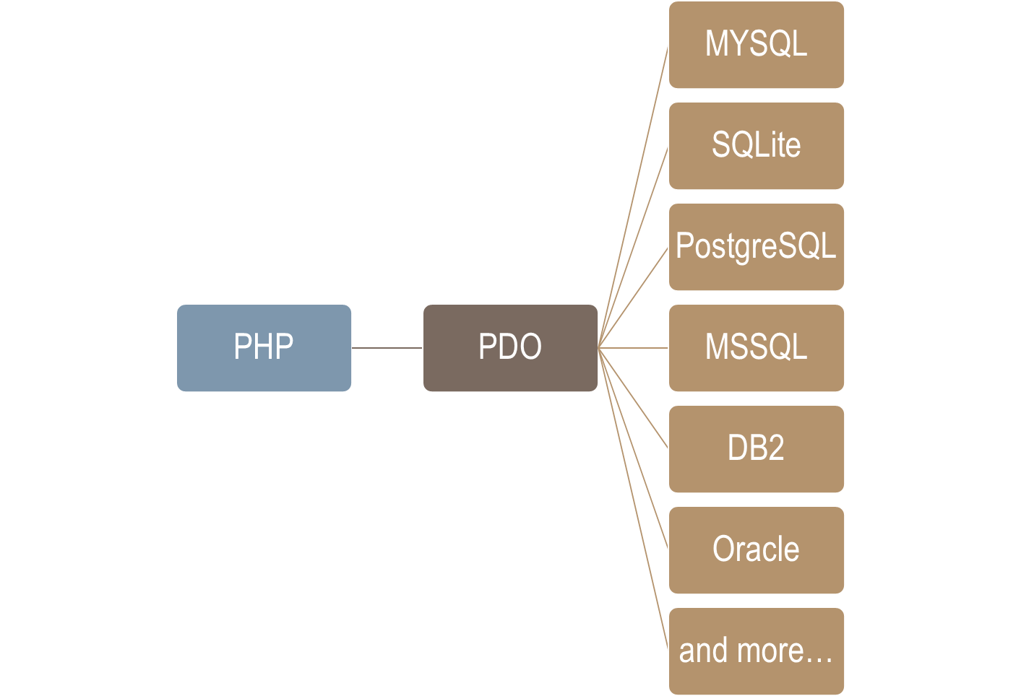
PDO
Dr. L.M. Jenila Livingston, VIT Chennai

Slide 4
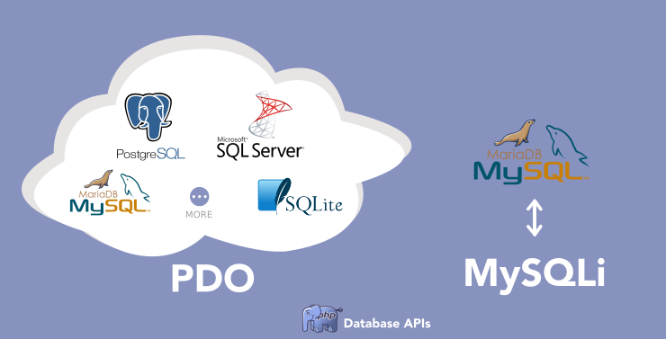
PDO Vs MySQLi
Dr. L.M. Jenila Livingston, VIT Chennai

Slide 5
University Database
Student Table
RegNo | SName | Mobile
19BCE1001 | Rahul | 9000333333
19BCE1003 | Liana | 9000044444
19BAI1001 | Rna | 9000044455
Dr. L.M. Jenila Livingston, VIT Chennai

Slide 6
Two methods to connect DB using DBO
Query(): non- parameterized query
Prepare(): parameterized query
Dr. L.M. Jenila Livingston, VIT Chennai

Slide 7
Method 1: DBO (query) – non-parameterized query
Connection for DB
Execute query using query()
Fetch data
If there are no variables going to be used in the query, we can use a conventional query() method instead of prepare and execute.
query() : returns a result set as a PDO statement.
Dr. L.M. Jenila Livingston, VIT Chennai

Slide 8
1. Connection for DB using credentials
Syntax:
<?php
$db = new PDO(“mysql:host=hostname;
dbname=databasename”, ”usernam”, ”password”);
?>
Eg:
<?php
$dbh = new PDO(“mysql:host=localhost;
dbname=univ”, ”root”, ”tiger”);
?>
Dr. L.M. Jenila Livingston, VIT Chennai

Slide 9
2. Execute Query
$sql=“SELECT * FROM stu”;
$stud = $dbh->query($sql)
foreach($stud as $row)
{
print_r($row);
}
Dr. L.M. Jenila Livingston, VIT Chennai

Slide 10
3. Fetch Data
fetch using associative array – foreach statement is used
fetch(): Fetches the next row from a result set
fetchAll(): Returns the whole result set as an array
fetchColumn(): Returns a single column of the next row
Dr. L.M. Jenila Livingston, VIT Chennai

Slide 11
Fetch data
$result = $stmt ->fetchAll();
print_r($result);
print("Fetch the first column from the first row in the result set:\n");
$result = $sth->fetchColumn();
print("name = $result\n");
print("Fetch the second column from the second row in the result set:\n");
$result = $sth->fetchColumn(1);
print("colour = $result\n");
Dr. L.M. Jenila Livingston, VIT Chennai

Slide 12
Example 1 : fetch a single row
// getting the last registered user
$stmt = $dbh->query ("SELECT * FROM employee ORDER BY id DESC LIMIT 1");
$user = $stmt->fetch();
Dr. L.M. Jenila Livingston, VIT Chennai

Slide 13
Example 2 : fetch as fetchAll
use the fetch() method within a while loop to fetch multiple rows:
$stmt = $dbh->query ("SELECT * FROM employee");
while ($row = $stmt->fetch()) {
echo $row['name']."<br />\n";
}
Dr. L.M. Jenila Livingston, VIT Chennai

Slide 14
Example 3 : fetchAll
use the fetch() method within a while loop to fetch multiple rows:
$data = $dbh->query ("SELECT * FROM employee")->fetchAll();
foreach ($data as $row)
{
echo $row['name']."<br />\n";
}
Dr. L.M. Jenila Livingston, VIT Chennai

Slide 15
Example 4: fetch multiple rows
$stmt = $dbh->query ("SELECT * FROM employee LIMIT ?, ?");
$stmt->execute([$limit, $offset]);
while ($row = $stmt->fetch()) {
echo $row['name']."<br />\n";
}
Dr. L.M. Jenila Livingston, VIT Chennai

Slide 16
Sample Program – Step1
<?php
$host = "localhost";
$user = "root";
$pass = "";
$db = “univ";
try
{
  $connect = new PDO("mysql:host=$host;dbname=$db",$user,$pass);
  // set the PDO error mode to exception
  $connect->setAttribute(PDO::ATTR_ERRMODE, PDO::ERRMODE_EXCEPTION);
}
catch(PDOException $e)
{
$e->getMessage();
}
?>
Dr. L.M. Jenila Livingston, VIT Chennai

Slide 17
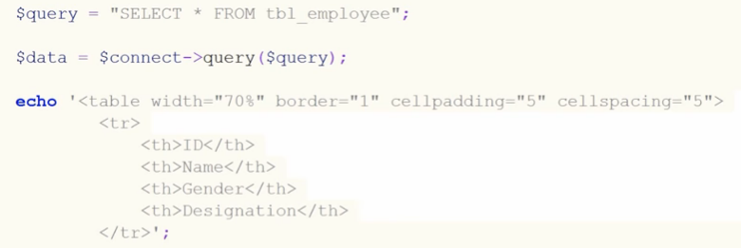
Sample Program – Step2
Dr. L.M. Jenila Livingston, VIT Chennai

Slide 18
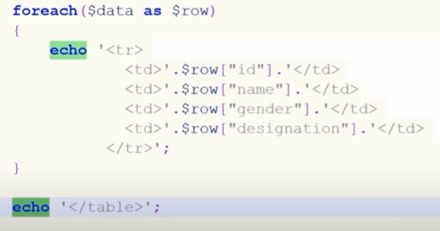
Sample Program – Step3
Dr. L.M. Jenila Livingston, VIT Chennai

Slide 19
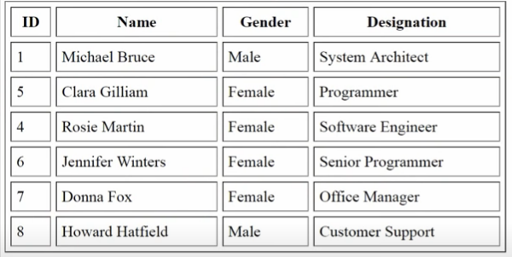
Employee table output
https://www.youtube.com/watch?v=Z7t4TDqMCSE
Dr. L.M. Jenila Livingston, VIT Chennai

Slide 20
Method 2: DBO (prepare) – parameterized query
Connection for DB
Prepare Statements
Execute Statements
Fetch Data
Dr. L.M. Jenila Livingston, VIT Chennai

Slide 21
1. Connection for DB using credentials
Syntax:
<?php
$db = new PDO(“mysql:host=hostname; dbname=databasename”, ”username”, ”password”);
?>
Eg:
<?php
$dbh = new PDO(“mysql:host=localhost;
dbname=univ”, ”root”, ”tiger”);
?>
Dr. L.M. Jenila Livingston, VIT Chennai

Slide 22
2. Prepare Statements
Returns a result set as a PDO statement
We can use question marks (?) for vlaues
Call execute() method
$rno = ’19BCE1001’;
$stmt = $dbh->prepare('SELECT regno, sname, mobile FROM stu WHERE regno:rno');
Dr. L.M. Jenila Livingston, VIT Chennai

Slide 23
3. Execute Statements
$stmt ->execute();
$stmt->execute(array(‘:id’ => 1))
$stmt->execute([‘:id’ => 1])
Dr. L.M. Jenila Livingston, VIT Chennai

Slide 24
4. Fetch Data
Fetch using associative array
fetch(): Fetches the next row from a result set
fetchAll(): Returns the whole result set as an array
fetchColumn(): Returns a single column of the next row
Dr. L.M. Jenila Livingston, VIT Chennai

Slide 25
Example 1 : named placeholders
// select a particular user by id
$stmt = $dbh->prepare ("SELECT * FROM employee WHERE id=:id");
$stmt->execute(['id' => $id]);
$user = $stmt->fetch();
Dr. L.M. Jenila Livingston, VIT Chennai

Slide 26
Example 2 : positional placeholder
// select a particular user by id
$stmt = $dbh->prepare ("SELECT * FROM employee WHERE id=?");
$stmt->execute([$id]);
$user = $stmt->fetch();
Dr. L.M. Jenila Livingston, VIT Chennai

Slide 27

Example 3
$stmt=$dbh->prepare (select * from employee where id=:id”);
$stmt->execute(array(‘:id’ => 5))
$user = $stmt->fetch();
Dr. L.M. Jenila Livingston, VIT Chennai

Slide 28
Example 4 :
Fetching multiple rows from a prepared query would be identical to that from a query without parameters
$stmt = $dbh->prepare ("SELECT * FROM employee LIMIT :limit, :offset");
$stmt->execute (['limit' => $limit, 'offset' => $offset]);
$data = $stmt->fetchAll();
foreach ($data as $row) {
echo $row['name']."<br />\n";
}
Dr. L.M. Jenila Livingston, VIT Chennai

Slide 29
Sample Program – Step1
<?php
$host = "localhost";
$user = "root";
$pass = "";
$db = “univ";
try
{
  $connect = new PDO("mysql:host=$host;dbname=$db",$user,$pass);
  // set the PDO error mode to exception
  $connect->setAttribute(PDO::ATTR_ERRMODE, PDO::ERRMODE_EXCEPTION);
}
catch(PDOException $e)
{
$e->getMessage();
}
?>
Dr. L.M. Jenila Livingston, VIT Chennai

Slide 30
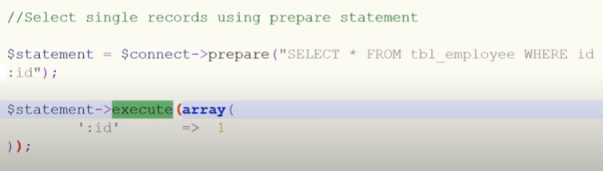
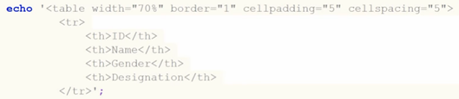
Sample Program – Step2
Dr. L.M. Jenila Livingston, VIT Chennai

Slide 31
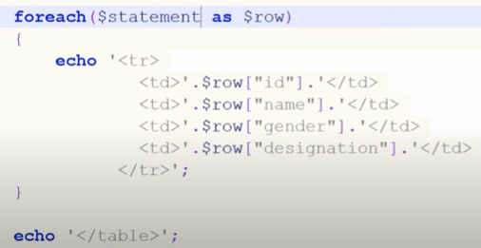
Sample Program – Step3
Dr. L.M. Jenila Livingston, VIT Chennai

Slide 32
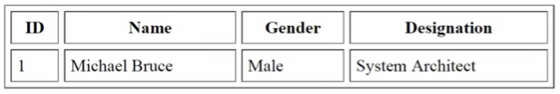
Employee table output
https://www.youtube.com/watch?v=Z7t4TDqMCSE
Dr. L.M. Jenila Livingston, VIT Chennai

Slide 33
Close the connection.
$dbh = new PDO(“mysql:host=localhost;
dbname=univ”, ”root”, ”tiger”);
….
$dbh = null;
Dr. L.M. Jenila Livingston, VIT Chennai

Slide 34

Dr. L.M. Jenila Livingston, VIT Chennai

